Slide 1
S01L01. Introduction of Data Mining

Slide 2

Introduction to Data Mining
Mining the data.
Finding hidden insights(information) from the database, and extract patterns from the data.
By combining three intertwined disciplines -
Statistics
Artificial intelligence and
Machine learning.

Slide 3

Data Mining
Automated process that consists of searching large datasets for patterns humans might not spot.
Weather forecasting
It analyzes troves of historical data to identify patterns and predict future weather conditions

Slide 4
How does Data Mining Work?
Data Mining uses- Supply chains to healthcare, advertising, and marketing.
Spotify’s AI recommendation engine
Proprietary algorithms to understand a user’s music tastes and point the user towards new genres, artists, and tracks.

Slide 5
How does Data Mining Work?
Insurance companies
Evaluate the risk of a life insurance applicant and assign them a corresponding premium.
Doctors
Check whether premature babies are developing dangerous infections.

Slide 6
S01L02. Why is data mining necessary?

Slide 7
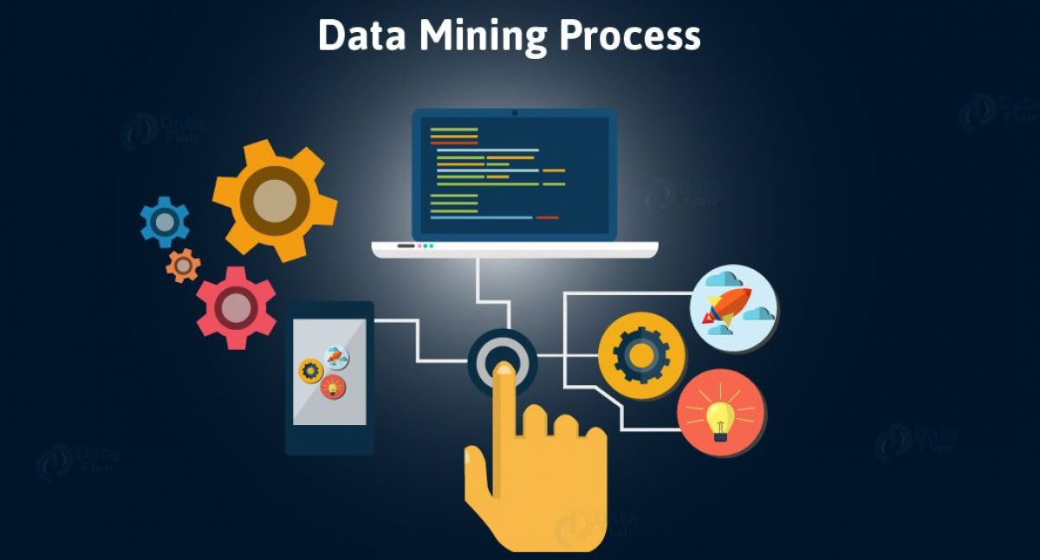
Data Mining Process
Starts with client
Customer Relationship Management (CRM)
Competitive data
Industry survey data
Blogs
social media conversations

Slide 8

Why is Data Mining necessary?
Analyzing and exploring data to discover patterns and trends.
Analyzing enormous sets of data and then extracting the meaning of the data.
Predicts behaviours and future trends.
Allowing businesses to make proactive, knowledge-driven decisions.

Slide 9
Data Mining elements
Extract, transform and load transaction data on to data warehouse.
Store and Manage data in a multidimensional database system.
Provide data access to business analysts and information technology professionals.
Analyze the data by application software.
Present the data in a useful format such as a graph or table.

Slide 10
C01S02L01. Introduction to KDD

Slide 11
Knowledge Discovery in Databases (KDD)
Process of collecting data and methodically refining it.
To purge the ‘noise’
Data mining is often used interchangeably with KDD.
To encompass the overall process of discovering useful knowledge from data.
Data mining refers to one of the steps in the KDD process.

Slide 12
Need of KDD or Data mining
Data is only valuable when you can parse, sort, and sift through it in order to extrapolate the actual value.
Graphs, charts, and trends data models, pure data.
The sheer volume of data and the speed with which it is collected makes sifting.
To handle the vast amount of data that we now obtain.

Slide 13
Alternative to KDD?
To derive knowledge from quickly accumulating data.
Other common processes are:-
SEMMA
Cross Industry Standard process in Data Mining(CRISP-DM) etc

Slide 14
C01S02L01. Introduction to KDD

Slide 15
KDD process steps
Selection:
Upon a database of compiled data and the targeted data is determined and also the variables that will be used for evaluating the knowledge discovery.
Pre-Processing:
All about improving the data being worked with.
Improving the data means the data cleaning concept.

Slide 16
Data Cleaning
As removal of noisy and irrelevant data from collection.
The following steps:-
Missing Values
Noisy data
where there is random noise or variance error.
Data Discrepancy detection and Data transformation tools.

Slide 17
KDD process steps
Transformation:
On converting the pre-processed data to fully utilizable kind.
By narrowing the scope in terms of variety and data attributes are firmly established for coming evaluation.
Information is organized and sorted.

Slide 18
Data Transformation
Data transformation is a two step process:-
Data Mapping- assigning elements from source base to destination to capture transformations.
Code generation- creation of the actual transformation program.

Slide 19
Data Mining
Data mining:
Applied to extract patterns potentially useful.
The patterns are graphed, trended, charted in the form particularly helpful to the process KDD is being conducted for.
This step involves:-
Transformation task relevant data into patterns.
Decides purpose of model using classification or characterization.

Slide 20
KDD process steps
Interpretation/ Evaluation:
The data is handed off for interpretation and documentation.
Data has been
Cleaned,
Converted,
Picked apart based on relevant attributes, and
Framed into visual representations.

Slide 21
KDD process steps
Note:
KDD is an iterative process where evaluation measures can be enhanced, mining can be refined, new data can be integrated and transformed in order to get different and more appropriate results.
Preprocessing databases consists of Data Cleaning and Data Integration.

Slide 22
C01S02L03. Pros and Cons of KDD

Slide 23
Advantages of KDD Process
Market Forecasting:
Predictive nature of consumer trends, identifying where the product focus should lie, and assists in predicting what other types of products consumers will want.
Businesses gain a competitive edge over others in their field.

Slide 24
Advantages of KDD Process
Iterative Process:
Knowledge acquired is cycled back into the process, enhancing its efficacy.
Data is better refined at each stage by using formally acquired and previously unknown information.
Creates a loop that continues after the implementation of the final result feeding right back into the establishment of objectives.

Slide 25
Advantages of KDD Process
Anomaly Identification:
Know about holes in a process, or security vulnerabilities.
Utilizing their knowledge to bolster our process efficiency and security.
Helping future utilization development.

Slide 26
Disadvantages of KDD Process
Outdated:
KDD process is now outdated.
Process doesn’t address a lot of the modern realities of data science projects such as
Setup of big data architecture
Considerations of ethics, or
Various roles in a data science team.

Slide 27
Disadvantages of KDD Process
Expensive:
Storing massive, ever-developing volumes of data carries an obvious upfront cost.
Depending on the type of data collected, there might be a high cost associated with compiling it. Space and maintenance of the data, even before any learning work can come at a high cost.

Slide 28
Disadvantages of KDD Process
Security Vulnerability:
Businesses need to know as much as they can about their customers. That means that data collection needs to be securely stored.
While the KDD process works on the data, assurances must be taken to ensure that the data is not hacked, stolen, or compromised.

Slide 29
Disadvantages of KDD Process
Privacy:
In order to acquire more knowledge, businesses have to collect as much data as possible.
Many companies’ legal terms forbid them from collecting certain information, something that is limiting to their process.
Often the collected data is leaked or stolen, creating an even bigger calamity.

Slide 30
Disadvantages of KDD Process
Takes Time:
More knowledge is acquired.
Applied back to bolster the process’s next iteration.
More additional data has been collected that requires sifting through, meaning that the process is sure to take additional time.

Slide 31
Disadvantages of KDD Process
Waterfall:
While the step-by-step phased process can be used as an iterative process, it may also lead teams to fall into the rigid and sluggish shortcomings of waterfall.
For best results, combine the KDD Process with more modern Agile Processes limit responsiveness to the ever-shifting project needs.

Slide 32
C01S02L04. Introducing SEMMA

Slide 33
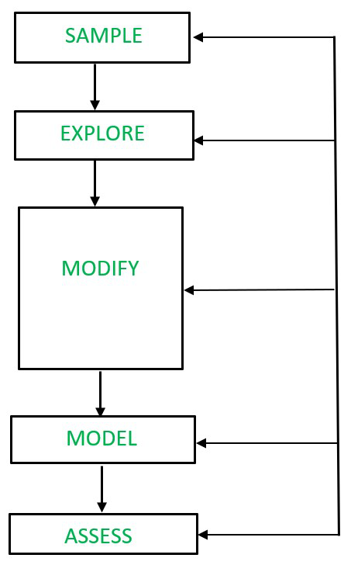
SEMMA
The acronym SEMMA stands for
Sample
Explore
Modify
Model
Access

Slide 34
SEMMA
To achieve a competitive advantage, improve performance and deliver more useful services to customers.
Serve as the foundation for hypotheses and models of the world we live in.
Data is accumulated to help in collecting knowledge.

Slide 35
SEMMA
Not equivalent to gathering valuable knowledge.
When data is sorted and evaluated that we learn anything from it.
The SAS institute developed SEMMA as the process of data mining.

Slide 36
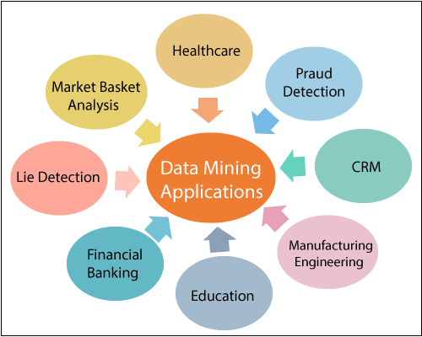
Uses of Data Mining
Fraud identification
Customer retention
Turnover
Database marketing,
Customer loyalty,
Bankruptcy forecasting,
Market segmentation as well as
Risk, affinity and portfolio analysis.

Slide 37
C01S02L05. 5 stages of SEMMA

Slide 38
SEMMA
Organized
Functional toolset
Claimed as such by SAS to be associated with their SAS Enterprise Miner initiative.
SEMMA process is more ambiguous to those not using the tool
Functional data mining methodology

Slide 39
Process
Sample:
Subset of the appropriate volume dataset from a vast dataset
Goal:-
identify variables or factors influencing the process.
Collected information is then sorted into preparation and validation categories.

Slide 40
Process
Explore:
Univariate and Multivariate analysis is conducted in order to study interconnected relationships between data elements and to identify gaps in the data.
The univariate one looks at each factor individually to understand its part in the overall scheme.
With heavy reliance on data visualization.

Slide 41
Process
Modify:
Data collected in the sample phase are derived with the application of business logic.
Data is parsed and cleaned
Passed onto modeling stage, and explored if the data requires refinement and transformation.

Slide 42
Process
Model:
Apply different data mining techniques
Access:
The model is evaluated for how useful and reliable it is.
Data can now be tested and used to estimate the efficacy of its performance.

Slide 43
C01S02L06. Introduction to CRISP-DM

Slide 44
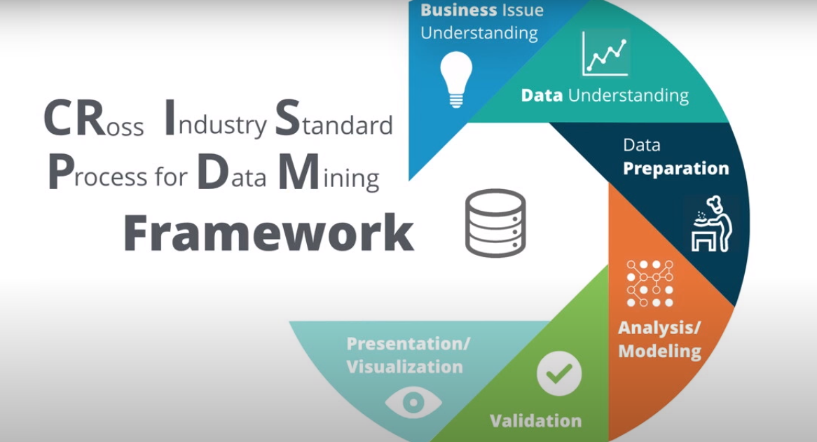
CRISP-DM
Cross-Industry Standard Process for Data Mining.
CRISP-DM includes descriptions of the typical phases of a project, the tasks involved with each phase and an explanation of the relationships between these tasks.
As a process model, CRISP-DM provides an overview of the data mining life-cycle.

Slide 45
CRISP-DM
CRISP-DM is basically a process model with six phases that naturally describes the data science life cycle.
It’s like a set of guardrails to help us:-
Plan
Organize
Implement our data science or machine learning project.

Slide 46
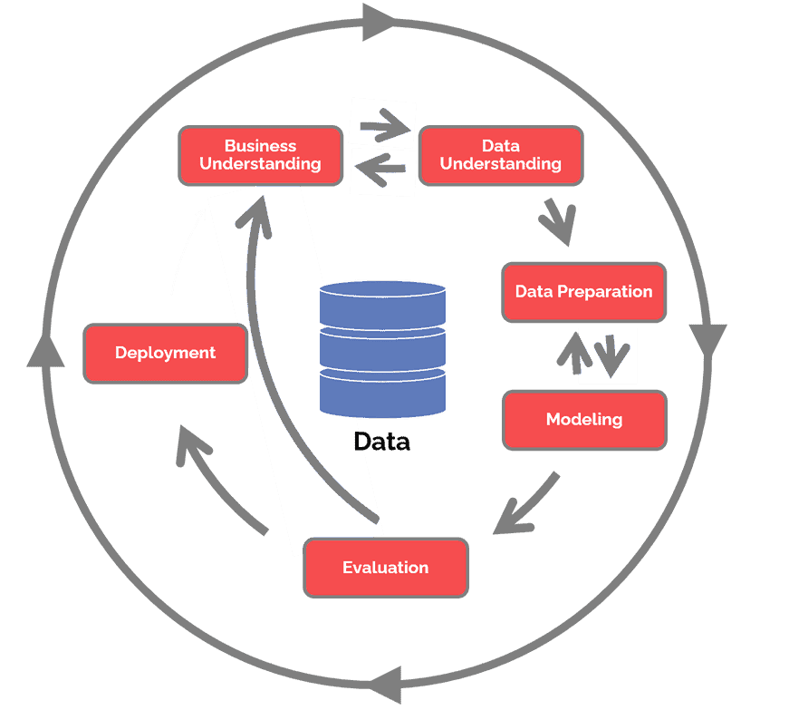
CRISP-DM
Business Understanding
Data Understanding
Data Preparation
Modeling
Evaluation
Deployment

Slide 47
CRISP-DM
Data science teams combine a loose implementation of CRISP-DM with overarching team-based agile project management approaches
Even teams that don’t explicitly follow CRISP-DM, can still use the framework diagram to explain the differences between data science and software projects.
Flexible and can be customized easily.

Slide 48
CRISP-DM
Organization aims to detect money laundering, it is likely that we will sift through large amounts of data without a specific modeling goal.
Our work will focus on data exploration and visualization to uncover suspicious patterns in financial data.
Allows us to create a data mining model that fits the particular needs.
The modeling, evaluation, and deployment phases might be less relevant than the data understanding and preparation phases.

Slide 49
C01S02L07. CRISP-DM Phases

Slide 50
CRISP-DM Phases
Business Understanding
Data Understanding
Data Preparation
Modeling
Evaluation
Deployment

Slide 51
CRISP-DM Phases- Business Understanding
Focuses on understanding the objectives and requirements.
Determine business objectives
Thoroughly understand from a business perspective ‘what the customer really wants to accomplish’ and define business success criteria.
Assess situation
Determine resources availability, project requirements, assess risks and conduct cost benefit analysis.

Slide 52
CRISP-DM Phases- Business Understanding
Determine Data Mining goals
Defines what success looks like from a technical data mining perspective.
Produce Project Plan
Select technologies and tools and define detailed plans for each project phase.

Slide 53
CRISP-DM Phases- Data Understanding
Drives the focus to identify, collect and analyze the datasets.
Collect initial data
Acquire the necessary data, load it into analysis tool.
Describe data
Examine the data and document its surface properties like data format, no of records and field identities.

Slide 54
CRISP-DM Phases- Data Understanding
Explore data
Dig deeper into data.
Query it
Visualise it
Identify relationships among the data
Verify data quality
How clean/dirty is the data?
Document any quality issues

Slide 55
CRISP-DM Phases- Data Preparation
Data Munging
Select data
Determine which datasets will be used?
Document reasons for inclusion/exclusion
Clean Data
Correct
Impute
Remove erroneous values

Slide 56
CRISP-DM Phases- Data Preparation
Construct data
Derive new attributes
Derive BMI from height and weight
Integrate data
Create new data sets by combining data from multiple sources
Format Data
Re-format data as necessary
Convert string values that store number to numeric values

Slide 57
CRISP-DM Phases- Modeling
Select modeling techniques
Determine which algorithms to try
Generate test design
Split the data into training, test and validation sets
Build model
reg = LinearRegression().fit(X, y)
Assess model
Domain knowledge, pre-defined success criteria and test design.

Slide 58
CRISP-DM Phases- Evaluation
Evaluate results
Do the models meet the business criteria?
Which one should we approve for the business?
Review process
Review the work accomplished
Was anything overlooked?
Were all steps properly executed?
Summarize findings and correct anything if needed.

Slide 59
CRISP-DM Phases- Evaluation
Determine next steps
Determine whether to proceed to deployment
Iterate further
Initiate new projects

Slide 60
CRISP-DM Phases- Deployment
Plan Deployment
Develop and document a plan for deploying the model
Plan monitoring and maintenance
To avoid issues during operational phase of a model
Produce final report
Document a summary of the project
Review product
Retrospective about what went well, what could have been better and how to improve.

Slide 61
C01S02L08. Pros and Cons of CRISP-DM

Slide 62
Advantages of CRISP-DM
Generalizable
Provides strong guidance for most of advanced data science activities.
Common sense
Adoptable
Implemented without much training, organizational role changes

Slide 63
Advantages of CRISP-DM
Right start
Initial focus on business understanding is helpful
Aligns technical work with business needs
Strong finish
Deployment likewise addresses important considerations to close out the project and transition to maintenance and operations.

Slide 64
Advantages of CRISP-DM
Flexible
Flexible to provide many of the benefits of agile principles and practices.
Project starts with significant unknowns
Users cycle through each steps
Gaining deeper understanding of the data and problem

Slide 65
Disadvantages of CRISP-DM
Rigid
Always a requirement of moving back and forth between different phases.
Documentation heavy
CRISP-DM’s documentation unnecessarily slow down team from actually delivering increments
Not modern
A process that predates big data, “might not be suitable for Big Data projects.

Slide 66
Disadvantages of CRISP-DM
Not a project management approach
CRISP-DM is not a true project management methodology
Assumes its user is a single person or small tight-knit team
Ignores the teamwork coordination necessary for larger projects.

Slide 67
C01S02L09. Introducing TDSP

Slide 68
Introduction to TDSP
Team Data Science Process
Agile
Iterative data science methodology
Modern data science lifecycle that incorporates team aspect of executing projects.

Slide 69
Components of TDSP
Four major components
Data Science lifecycle definition.
Standardized project structure.
Recommended infrastructure and resources.
Recommended tools and utilities.
Lifecycle to structure the development of data science projects, outlining all the steps usually taken when executing a project.

Slide 70
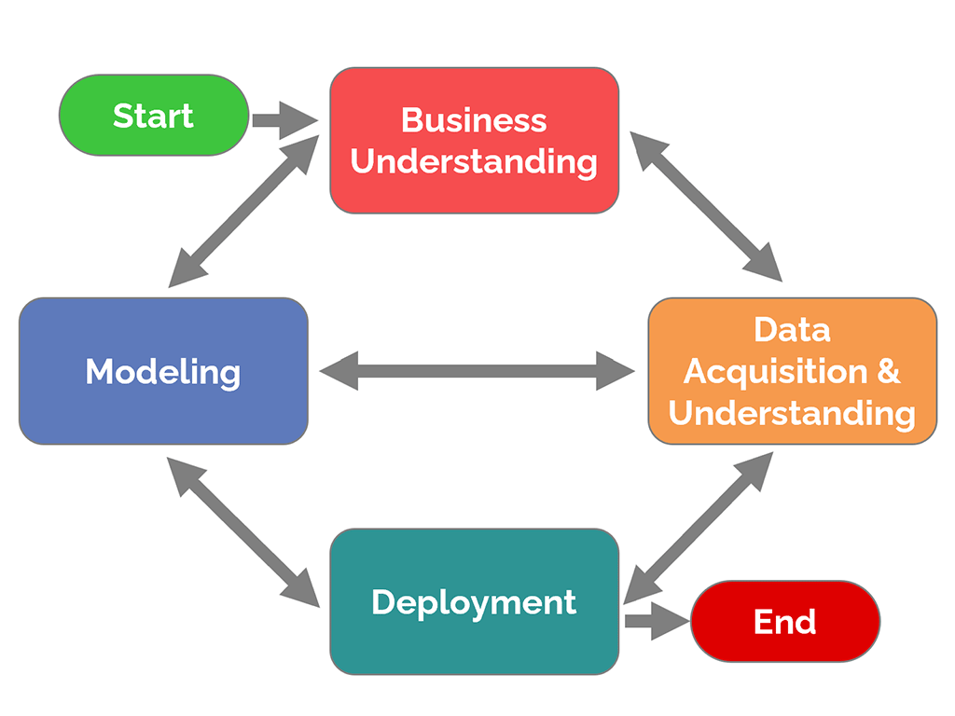
TDSP Lifecycle

Slide 71
TDSP Lifecycle
TDSP provides a lifecycle to structure the development of data science projects.
Includes five iterative stages: -
Business Understanding
Data Acquisition and Understanding
Modeling
Deployment
Customer Acceptance

Slide 72
Business Understanding
Business goals and the identification of the key business variables the analysis needs to predict.
Metrics that will be used to assess the success of the project are also defined in this stage.
Data sources and understanding the kind of data.
Determine if data collection or additional data sources will be needed.

Slide 73
Data Acquisition and Understanding
Revolves around data.
To assess the current state of the data.
Its size and quality.
The data is explored, preprocessed and cleaned.
To help data scientists build an initial data understanding.

Slide 74
Data Acquisition and Understanding
Aims at finding patterns in the data to guide the choice of the most appropriate modelling techniques to use.
Data scientists usually have a better idea of whether the existing data is sufficient.
Need to find new data sources to augment the initial dataset.
If the data is appropriate.

Slide 75
Modelling
Feature engineering is performed on the cleaned dataset in order to generate a new, improved, dataset that facilitates model training.
Insights obtained from the data exploration step and on the domain expertise of the data scientist.
Consists of informative features, several models are trained and evaluated.

Slide 76
Deployment
Deploying the data pipeline and the winner model to a production or production-like environment.
Model predictions can be made either in real-time or on a batch basis and this has to be decided in this stage.

Slide 77
Customer Acceptance
CRISP-DM equivalent is available, is customer acceptance.
Involves two important tasks:
System validation.
Project hand-off.

Slide 78
Customer Acceptance
To confirm that the deployed model meets the client’s needs and expectations.
Whereas the project hand-off includes handing-off the project to the person responsible of running the system in production, as well as delivering any project reports and documentation.

Slide 79
C01S02L10 Pros and Cons of TDSP

Slide 80
Advantages of TDSP
Agile:
TDSP emphasizes the need for incremental deliverables.
Familiar:
Product backlog, features, user stories, bugs, Git versioning, and sprint planning.

Slide 81
Advantages of TDSP
Data Science Native:
Data science and software engineering are different, and is built for data science teams working on production-bound projects.
Flexible:
TDSP can be implemented as it is defined or in conjunction with other approaches such as CRISP-DM.

Slide 82
Advantages of TDSP
Thorough:
TDSP is arguably the most mature CRISP-derived project management approach.
To Domino Data Lab’s Lifecycle but is more detailed.
Free Templates:
Go to Microsoft Azure’s GitHub repository to get started where we will get complete info about the TDSP.

Slide 83
Disadvantages of TDSP
Fixed Sprints:
TDSP leverages fixed-length planning sprints which many data scientists struggle with.
Some Inconsistencies:
Not all of Microsoft’s documentation is consistent.

Slide 84
C01S03L01. Introduction to Survival Analysis

Slide 85
What is Survival Analysis?
Set of statistical approaches used to investigate the time it takes for an event of interest to occur.
To estimate the lifespan of a particular population under study.
“Time to Event” Analysis as the goal is to estimate the time for an individual or a group of individuals to experience an event of interest.
Time estimate is the duration between birth and death events.

Slide 86
Survival Analysis
Survival Analysis was originally developed and used by Medical Researchers and Data Analysts to measure the lifetimes of a certain population.
Used in various other applications such as predicting churning customers/employees, estimation of the lifetime of a Machine, etc.

Slide 87
Survival Analysis
Birth event can be thought of as the time a customer starts their membership with a company, and the death event can be considered as the customer leaving the company.
Survival analysis is used in a variety of field such as:
Cancer studies for patients survival time analyses.
Sociology for “event-history analysis”.
Engineering for “failure-time analysis”.

Slide 88
Survival Analysis
Do not need the exact starting points and ending points.
All the observations do not always start at zero.
All the duration is relative.
All the subjects are brought to a common starting point where the time t is zero (t = 0) and all subjects have the survival probabilities equal to one, i.e their chances of not experiencing the event of interest (death, churn, etc) is 100%.

Slide 89
Survival Analysis
The volume of the data prevents it from being used completely in Survival Analysis.
Stratified Sampling.
An equal or nearly equal amount of subjects from each group of subjects in the whole population. Each group is called a Strata.

Slide 90
Survival Analysis
Whole population is stratified into groups based on some characteristic.
Total number of subjects is specified at the start and you split the total number required among each group and you pick that number of subjects randomly from each group.

Slide 91
Survival Analysis
There are several methods used in survival analysis:
Kaplan Meyer Estimator.
Censoring.
Log Rank Test.

Slide 92
C01S03L02. Kaplan Meyer Estimator

Slide 93
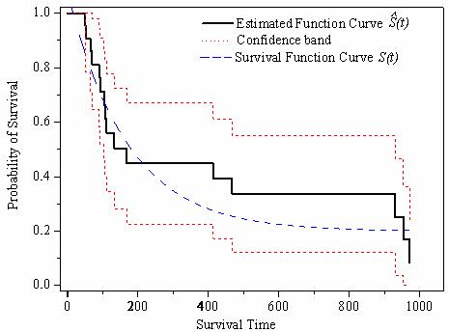
Kaplan-Meyer
Non-parametric technique of estimating and plotting the survival probability as a function of time.
Requires the least assumptions.

Slide 94
Kaplan-Meyer Approach
Event of interest is unambiguous and happens at a specified time.
The survival probability of all observations is the same.
Censored observations have the same survival prospects as observations.

Slide 95
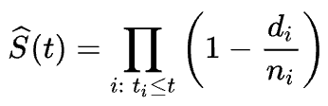
Kaplan-Meyer Approach
Fraction of observations who survived for a certain amount of time under the same circumstances and is given by the following formula:
where:
t_i is a time
d_i is the number of events.
n_i represents the number of individuals.

Slide 96
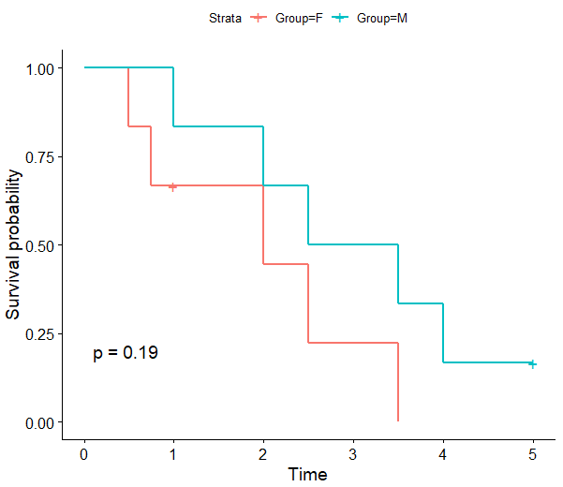
Kaplan-Meyer Curves
Cohorts, groups that received some kind of treatment or not, behavioral clusters, etc.
Series of decreasing horizontal steps, which approach the shape of the population’s true survival function given a large enough sample size.

Slide 97
C01S03L03. Censoring

Slide 98
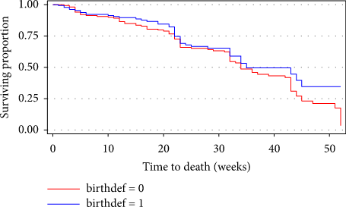
Survival Analysis
To estimate the lifespan of a particular population under study.
Time to Event:
The time for an individual or a group of individuals to experience an event of interest.
Duration between birth and death events.

Slide 99
Survival Analysis
For example: Customers who are still a member of the company, or employees still working for the company, or machines that are still functioning during the observation/study period.
When they will experience the event of interest as of the time of the study.
Survival times are longer than their time in the study.

Slide 100
Types of Censorship in Survival Analysis
Right Censoring:
t=0 i.e at the start of the study and terminates before the event of interest occurs.
Left Censoring: When the birth event wasn’t observed.
The lifelines package has support for left-censored datasets by adding the keyword left_censoring=True.

Slide 101
Types of Censorship in Survival Analysis
Interval Censoring:
When the follow-up period, i.e time between observation, is not continuous.
Weekly, monthly, quarterly, etc.
Left Truncation:
There is an argument named ‘entry’ that specifies the duration between birth and entering the study.

Slide 102
Survival Function
Survival function is given by the following function:-
S(t) = P(T>t)
T is the random lifetime taken from the population and it cannot be negative.
S(t) value lies between 0 and 1 and it is a non-increasing function.

Slide 103
C01S03L06. Log Rank Test Introduction

Slide 104
Log-Rank Test
Compares the survival probabilities between two groups.
Null hypothesis of the test states no difference between the survival functions of the considered groups.
Hazard ratio should be constant throughout the study period.
The log-rank test might not be an appropriate test if the survival curves cross.

Slide 105
Log-Rank Test
Numbers at risk in the first and second groups in the sixth month were 70 and 30, respectively, and 10 deaths occurred in that month we would expect
10×70/(70+30)=7
of the deaths to have occurred in the first group.
10×30/(70+30)=3
of the deaths to have occurred in the second group.

Slide 106
C01S04L01. Introduction to Cox Hazard Regression

Slide 107
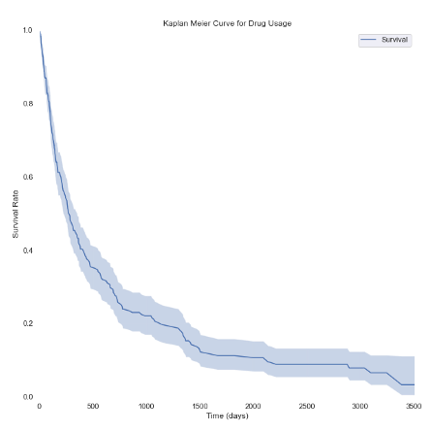
Cox Proportional Hazards model
X-axis- Time in days
Y-axis- Percentage of survivals
people live to certain age.
certain amount of time without breaking down.
whether someone remains unemployed a certain amount of time after losing their job.

Slide 108
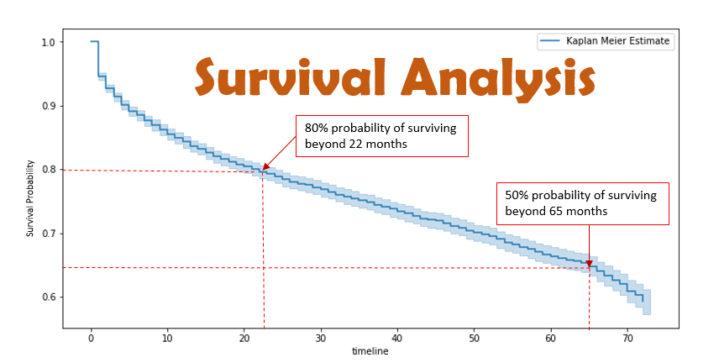
Survival function
Survival function is a function of time t.
It is the percentage of subjects surviving at time t.

Slide 109
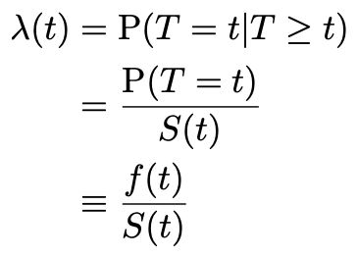
Hazard Rate
Hazard rate is the instantaneous probability of failure/death/state transition at a given time t, conditional on already having survived that long.

Slide 110
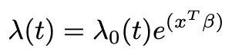
Cox Proportional Hazards model
Cox Proportional Hazard model is given in terms of:-
Time t
Covariate vector x
Coefficient vector β
λo- arbitrary function of time
Xβ is exponent

Slide 111
C01S07L01. Introduction to Association Analysis

Slide 112
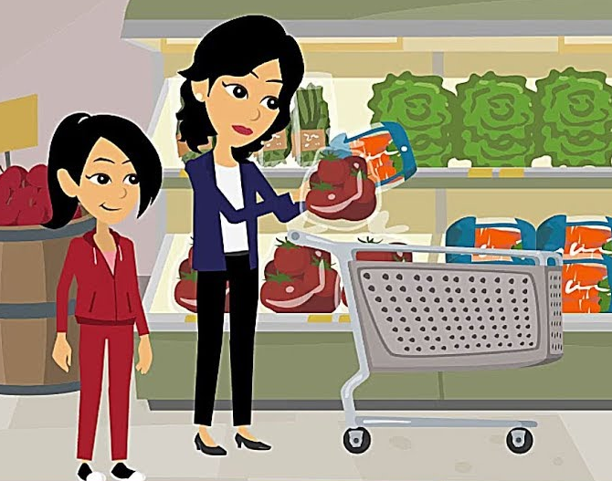
Introduction to Association Analysis
Items are displayed.
Coupons offered.
Loyalty programs all are driven by massive amounts of data crunching.

Slide 113
Loyalty Programs
The customer a discount by using a loyalty card, can give the store a glimpse at what one consumer is purchasing.
If we don’t use a loyalty card - the store can also look at the credit card you used to make the purchases.
If we don’t use a loyalty card and pay with cash, a store can look at the items purchased together.

Slide 114
Loyalty Programs
Idea of customers’ purchasing behavior.
Used for pricing, marketing promotions, inventory management, and so on.
Known as Association Analysis or Association Rule Learning.

Slide 115
Association Analysis
Association analysis is a hot topic in data science right now.
By discovering relationships between items within large quantities or networks of data.
Discovering patterns in
Healthcare
Transportation, or survey-based data.

Slide 116
Association Analysis
The relationships may be represented
{A} → {B}, where the two items
Where, A and B exhibit some sort of relationship.

Slide 117
C01S07L02. Association Rule Learning

Slide 118
Association Analysis
Relationships can take two forms:
Frequent itemsets
Association rules.
Collection of items that frequently occur together.
Suggest that a strong relationship exists between two items.

Slide 119
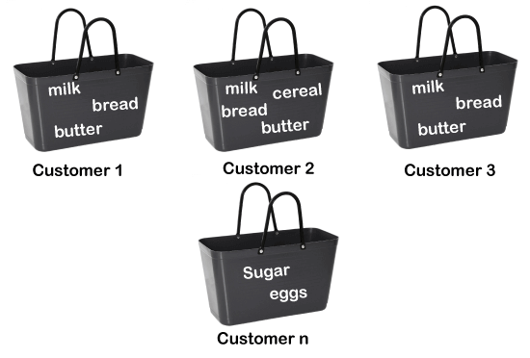
Association Analysis
Example:
List of items bought by different customers from a grocery store.

Slide 120
Association Analysis
Three types of algorithms:
Apriori Algorithm.
Eclat.
F-P Growth Algorithm.

Slide 121
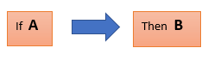
How it works?
Concept of If and Else Statement, such as if A then B.
‘If’ element is called ‘antecedent’.
‘Then’ statement is called Consequent.
Find out some association or correlation between two items is known as single cardinality.

Slide 122
How it works?
If the number of items increases, then cardinality also increases.
To measure the associations between thousands of data items. These metrics are given below:
Support
Confidence
Lift

Slide 123
Support metric
Support is the frequency of A.
How frequently an item appears.
Transaction T contains the itemset X.
If there are X datasets, then for transactions T,

Slide 124
Confidence metric
Often the rule has been found to be true.
How often the items X and Y occur together when the occurrence of X is already given.
Transaction that contains X and Y to the number of records that contain X.

Slide 125
Lift metric
It is the strength of any rule.
Observed support measure and expected support if X and Y are independent of each other.

Slide 126
Lift metric
Three possible values:
If Lift= 1: Occurrence of antecedent and consequent is independent of each other.
Lift>1: Degree to which the two itemsets are dependent on each other.
Lift<1: One item is a substitute for other items, which means one item has a negative effect on another.

Slide 127
C01S07L03. Creating Transaction List

Slide 128
Association Analysis
It is employed in
Market Basket analysis
Web usage mining
continuous production, etc.
Checks for the dependency of one data item on another data item.

Slide 129
Association Analysis
It tries to find some interesting relations or associations among the variables of the dataset.
It is based on different rules to discover the interesting relations between variables in the database.

Slide 130
C01S07L04. Encoding Transactions

Slide 131
Importance of encoding in Association Rule Learning
TransactionEncoder() is used for encoding the transactions.
TransactionEncoder learns the unique labels in the dataset.
TransactionEncoder transforms the input dataset
Python list of lists into a one-hot encoded NumPy Boolean array.

Slide 132
C01S07L05. Apriori Algorithm

Slide 133
Apriori Algorithm
Association Rule Mining Algorithm.
“Having prior knowledge of frequent itemsets can generate strong association rules.”
The word ‘Apriori’ means prior knowledge.

Slide 134
Candidate Itemset Generation
Iterative Approach.
K-itemsets are used to explore (K+1)-itemsets:
Set of frequent 1-itemset is found.
Frequent 2-itemset is found.
No more frequent k-itemsets can be found.
A candidate k-itemset is an itemset with k items in it.
Ex. Candidate 2-itemset can be [Bread, Butter].

Slide 135
Apriori Property
All non-empty subsets of a frequent itemset must also be frequent.
Ex. If [Bread, Butter] is a frequent itemset, then [Bread] and [Butter] must individually be frequent too.

